Slide 1




The Spectroscopic and Visual Orbit of Nitrogen-rich Massive Binary Wolf Rayet 138
Amanda Holdsworth
Mentor: Dr. Noel Richardson
Physics and Astronomy, College of Arts and Sciences.
A special thanks to the Arizona Space Grant Consortium for funding this research
Notes:
Good morning. I am Amanda Holdsworth, and will be presenting research on the Spectroscopic and Visual Orbit of the Nitrogen-rich Massive Binary Wolf Rayet 138. I’d like to give thanks to Doctor Richardson, for mentoring me, along with the Arizona Space Grant Consortium for funding this research.

Slide 2

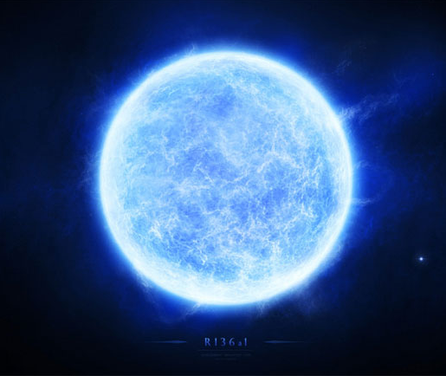
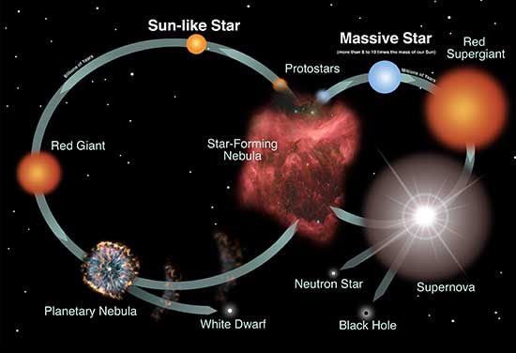
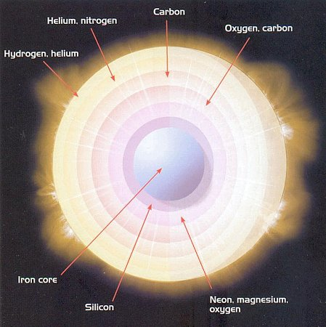
What are Wolf-Rayet (WR) Stars?
Evolved, massive stars
Outer hydrogen envelope stripped away
  Strong stellar winds
  Binary Interactions
Three flavors of WR stars
  WN – Nitrogen Rich
  WC – Carbon Rich
  WO – Oxygen Rich
Wolf-Rayet
Credit: NASA and the Night Sky Network
Figure 08-12b Wolf-Rayet Star
Notes:
Classical Wolf-Rayet Stars are evolved from massive main sequence OB-type stars, that have lost their outer hydrogen-rich envelope. These stars are at an advanced stage of stellar evolution and are losing mass at a very high rate. While it is not clear what causes the evolution of WR stars, the main contributors are thought to be either from strong winds and or from interactions with a binary companion star, both of which can cause mass loss of the WR star. Approximately ~90% of the known WR star population have Helium burning cores (Lefever et al. 2023). Spectroscopically, WR stars are distinguished by the presence of strong, broad emission lines, which are associated with wind carrying max fluxes and order of magnitude larger than those of ordinary O stars (Roy et al. 2020) There are three flavors of WR stars known. There are Nitrogen-Sequence WR, that are dominated by helium and nitrogen lines, there are Carbon-Sequence WR, that are dominated by carbon and helium lines, and finally, there are the rare oxygen-sequence WR that have prominent oxygen and carbon lines. (Crowther et al. 2022)

Slide 3
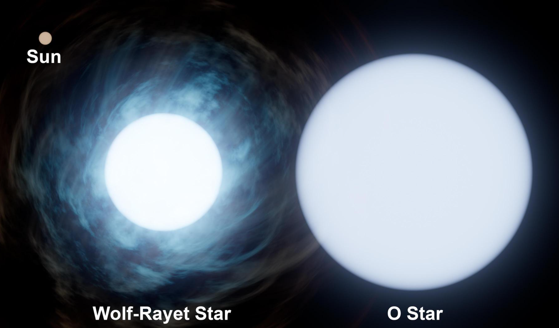
What is WR 138?
Nitrogen-rich WR star
Bright binary system
  Companion O Star
Long period - 4 years
Credit: NASA
Notes:
This research focuses on one particular WR binary. WR 138 is a Nitrogen sequence WR star. WR 138 has a companion main sequence late type O star. This system was resolved, and showed two objects separated by 12.4 mas using H-band CHARA interferometry (Richardson et al. 2016). This information suggests that WR 138 evolved through a previous mass-transfer episode that created the WR star and led to a spin-up of the O-type star. Past analysis on the star has allowed us to infer an orbital period of approximately 4 years (Annuk 1990).

Slide 4
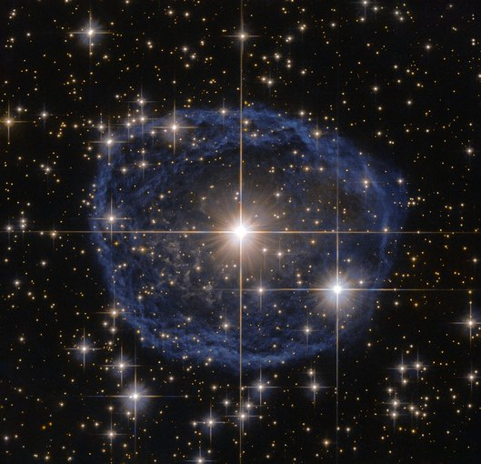
Purpose
CREDIT: ESA/HUBBLE & NASA, ACKNOWLEDGEMENT: JUDY SCHMIDT.
WRs important phase of stellar evolution
WR create nebulas
Not well understood
Studying them allows us to constrain how they are formed
Credit: ESA/Hubble & NASA, Acknowledgement: Judy Schmidt
Notes:
Due to their size and characteristics, WR stars are rare, but they represent one of the most important phases of stellar evolution, as they represent a final burst of activity before a massive star begins to die. While the fate of a WR star is likely dependent on how massive it is, many are thought to end their lives with spectacular explosions such as supernovas or gamma ray bursts. WR stars are also known to create nebulas, because their powerful winds sweep up interstellar material, which in turn allows for new stars to form.
The image on the screen shows WR 31, surrounded by a blue bubble. This blue bubble a nebula that has formed from the strong winds that have interacted with the outer layers of hydrogen ejected by the star.
However, due to their rarity, the evolution of WR stars are not well understood, leaving a gap of knowledge of the evolution of massive main sequence stars, and ultimately the evolution of the universe. Studying binary WR systems offers an opportunity to determine their masses, which in turn will allow us to constrain how WR stars evolve and are formed.

Slide 5
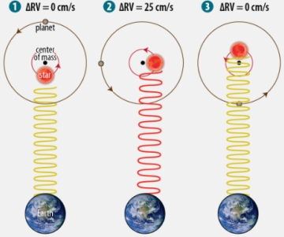
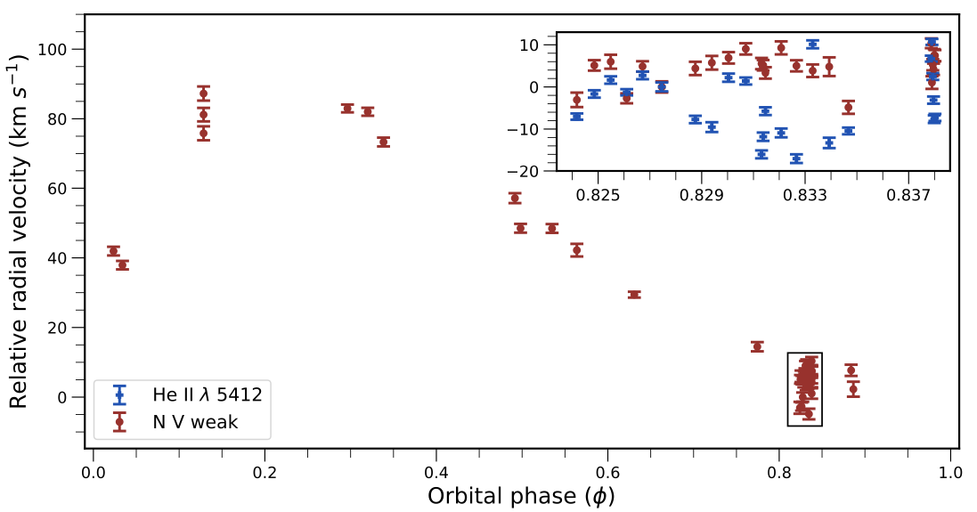
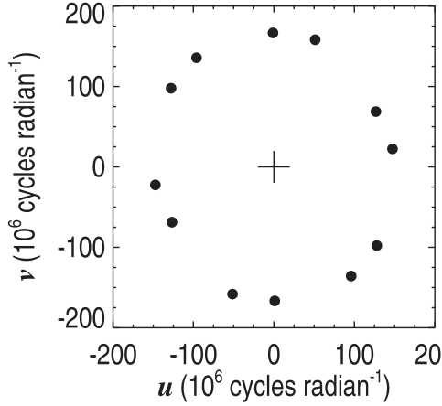
Data from Literature
Dsilva et al. 2022
Richardson et al. (2016)
Notes:
The radial velocity of a star, which is the velocity along the line of sight of the observer, is an important component for determining the minimum mass of stars in binary systems. When the radial velocity of a star is calculated and then plotted against time, the pattern that emerges is sinusoidal. If the orbit of the star has no eccentricity, then the plot of its radial velocity will be similar to a perfect sine wave. The more eccentric the orbit is, the less of perfect sine wave will appear.
The plot on the right shows the result of the measurements reported from Dsilva, using spectra from the HERMES spectrograph mounted on the 1.2m Mercator telescope in La Palma Spain. This plot comes from measuring the motion of the WR star itself. Because the orbit of the binary is elliptical rather than sinusoidal, the radial velocity plot is not a perfect sine wave. The black box surrounding some of the data shows the high-cadence measurements.
The lower left plot shows the plotted (u, v) plane, or aperture plane, of WR 138, from Richardson et al. published in 2016. This plot shows that while there are few points, the plane is still well covered.

Slide 6
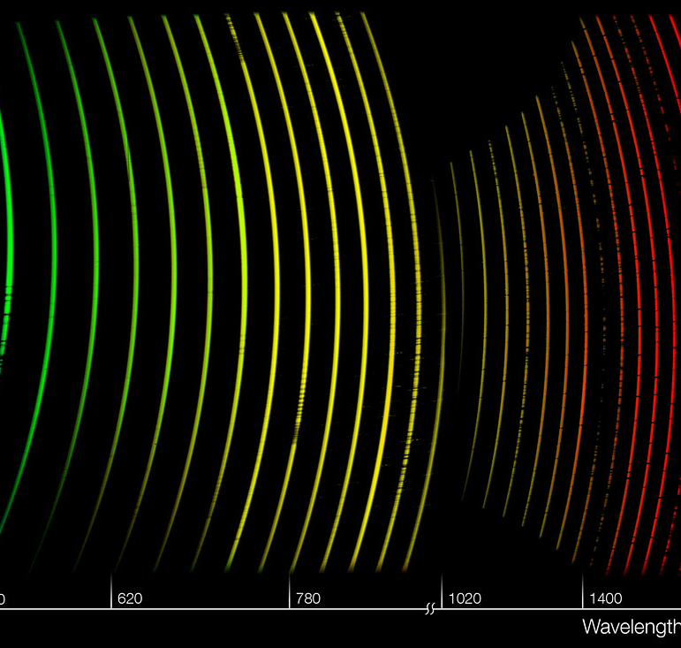
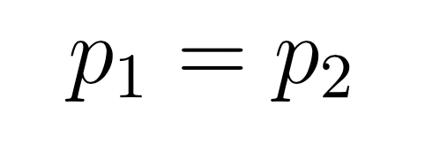
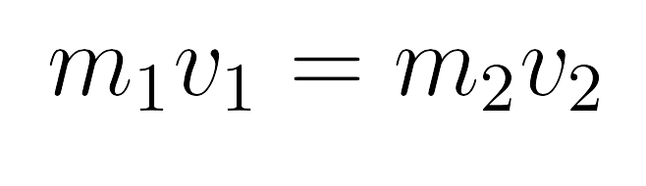
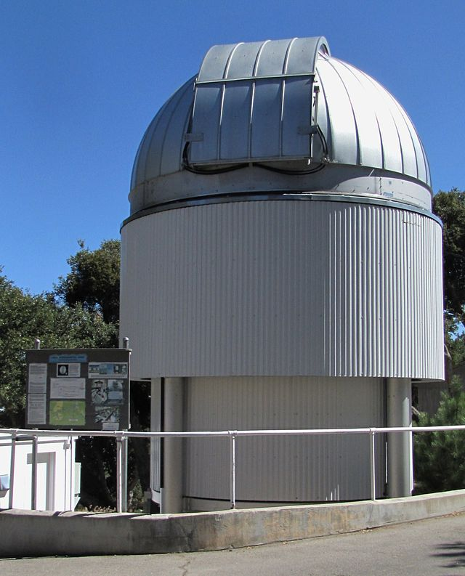
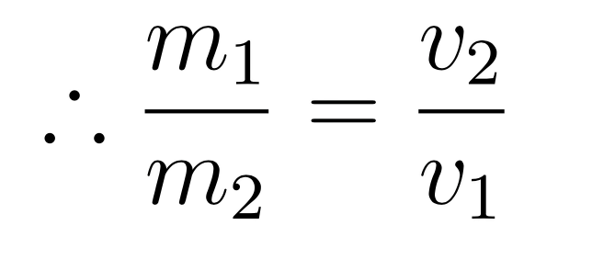
Research Approach
Spectroscopy
  Data reported by Dsilva et al. (2022)
  Dominican Astronomical Observatory (DAO)
Spectral data to measure motion of O star
Long-baseline optical interferometry
  CHARRA at Mt. Wilson CA
Interferometry to determine sum of masses
Illustration of a spectrum taken by X-shooter
Credit: Mount Wilson Observatory
Notes:
We are studying the bright binary with both spectroscopy and in the future, long-baseline optical interferometry with CHARRA found at Mt. Wilson California.
There are several sources that we will be using for the spectroscopy data. The first of which is the reported spectra from the Dsilva paper, previously mentioned. The second is from the Dominican Astronomical Observatory. We will be taking decades of archival data from DAO and adding it into the analysis.
With the spectral data, we will be measuring the motion of the O star, rather than the WR star itself. In an orbit, both stars have the same momentum. Dsilva has already provided the fit for the WR star, and so if we are able to fit the companion star, we can use the velocities of both stars as a ratio, which will in turn give us a mass ratio.
Following which, we will use interferometry to measure the visual orbit of the stars, which will give us the sum of the masses. The combination of both processes will give us precise stellar mass measurements.

Slide 7
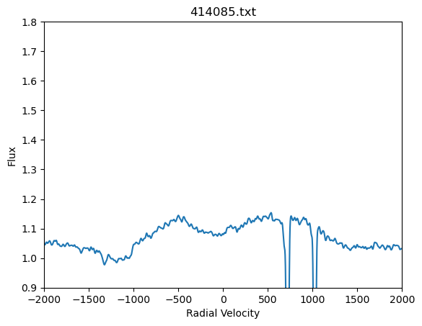
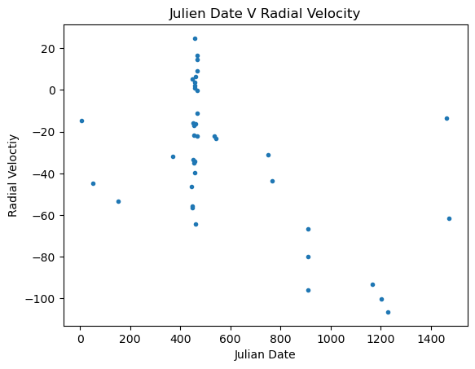
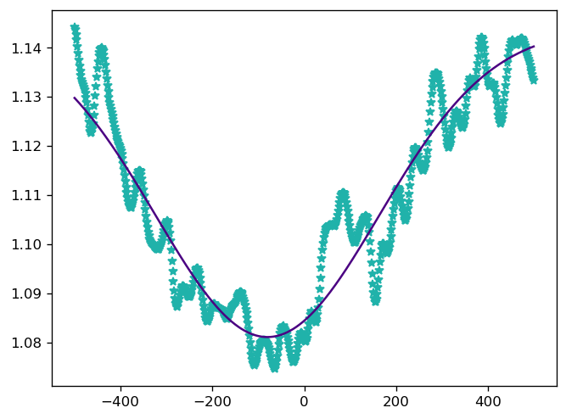
Current Data
Notes:
Our data, before analysis is in the form of wavelengths and fluxes. Prior to analzing the data, we must convert the wavelengths to velocities, after which, we plot the flux as a function of the radial velocity. From here we are able to perform a gaussian fit to the O star radial velocity, the center of which is the radial velocity of the O star. Performing this process for a series of nights, allows us to plot the radial velocity of the star as a function of time, similar to what Dsilva et al. did. To ensure that there are no shifts in the data, we are also measuring the velocity of the characteristic stellar Sodium lines, as they should not change over the course of time.
So far, we have analyzed the O star with the spectral data reported by Dsilva et al. However, we will also perform the same process with the DAO archival data.
The upper left image shows the spectral data of one trial, after it’s wavelength has been converted to radial velocity. The two large dips around 750 and 1000 are the two stellar Sodium lines. The O star occurs between -500 and 500.
The lower left plot is zoomed in on the radial velocity of the O star, which has a gaussian fit overlayed on top. We repeated this process for about 40 other data sets, and then plotted the radial velocity of each on its own graph over time, which can be seen on the upper right.
By comparing both datasets, we can see that the two have the same shape, but one is opposite from the other. This is to be expected, as the two stars are orbiting each other.

Slide 8
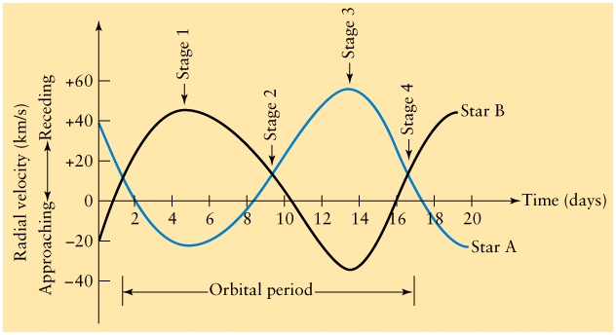
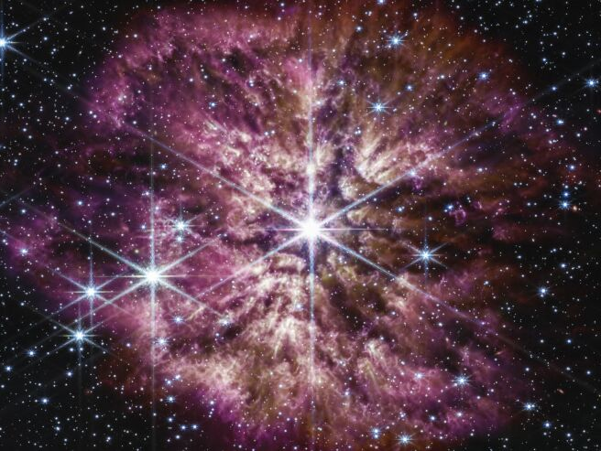
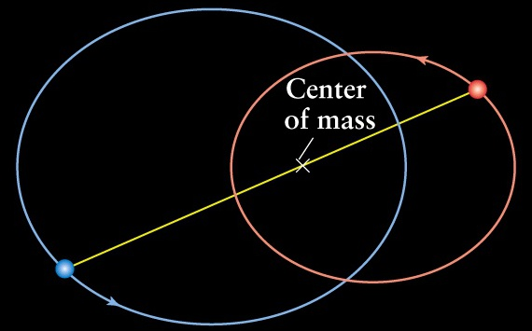
Future Steps
Analyze DAO Data
Calculate mass ratio of stars
Determine Visual orbit of the system
Calculate the sum of the masses
https://sites.ualberta.ca/~pogosyan/teaching/ASTRO_122/lect13/lecture13.html
WR 124 Credit: JWST & NASA
Notes:
We are currently working on analyzing the DAO archival data, in order to improve our Radial Velocity plot of the O star. Once that data has been analyzed, we will calculate the mass ratio of the stars, using the velocity ratio determined by the Dsilva paper, along with out plot. Following which, we will use the CHARRA interferometer to determine the visual orbit, which will allow us to determine the sum of the masses. Both combined will result in knowing the specific masses of both the stars.
I’d like to thank you for your time, and will now take any questions, if there are any.

Slide 9
References
Exploring the influence of different velocity fields on Wolf-Rayet star spectra
Lefever et al. 2023
​​https://ui.adsabs.harvard.edu/search/q=Hainich&sort=date%20desc%2C%20bibcode%20desc&p_=0
Helium and nitrogen enrichment in massive main-sequence stars: mechanisms and implications for the origin of WNL stars
Roy et al. 2020
https://academic.oup.com/mnras/article/494/3/3861/5815093
Line luminosities of Galactic and Magellanic Cloud Wolf-Rayet stars
Crowther et al. 2022
https://ui.adsabs.harvard.edu/abs/2023MNRAS.521..585C/abstract
A spectroscopic multiplicity survey of Galactic Wolf-Rayet stars
Dsilva et al. 2022
https://www.aanda.org/articles/aa/pdf/2022/08/aa42729-21.pdf
The CHARA Array resolves the long-period Wolf-Rayet binaries WR 137 and WR 138
Richardson et al. 2016
https://watermark.silverchair.com/stw1585.pdf?token=AQECAHi208BE49Ooan9kkhW_Ercy7Dm3ZL_9Cf3qfKAc485ysgAAAscwggLDBgkqhkiG9w0BBwagggK0MIICsAIBADCCAqkGCSqGSIb3DQEHATAeBglghkgBZQMEAS4wEQQMOFPa53nDVj6UcIqrAgEQgIICehLKi-NetDiYAGd127nmD_XgMXFxI1W3F5jXmaVD5e6u_FiyUXtNbDrh4byxuOkO7Ntsck4VTALbkjvYiW9gePqQ76Py9lHX9tqt09vtvZqy4DPQaJaKmPzvSYJy-h6Sqx7jaQeodh1Zr4luHf51A0dtic6DV5RU1MiZEXpi3lLplwAdwupXGlvK9bUt-ZI6RF4EVcC5T2ta_5lNshv3bjQKwx-oKcdD_H24-PeNo-yFdprWpVA02HlafEA6YWcf_D_98z4x6rGSsP72pyGFhBN5SqbPUv01Z0S2OtzhoTSW8_OobcPkb4BmcokVU8TqryjOcUgQOj--CvnXeV9vs1O9NNhEuQAgZlTbfbwR2Xxo15AixznnOi2Wf94eOZQlZ---U-_hxL2stHpoB5GNP9UdJbwVVu774mCAsuVIT90gkH4OTTUa1JkBGFHysiSz-BWgFiUMqAegO98f9yAUNEPTCdU7mRY-EQdxzmhm_1o_Fig2N65RFASM1ZnASAWS2aMwP3HJjqYTIZ-j8CaONU-7Sjj8nK_X5ovU_U01o9qzvrDuhKylxgdpIOhSe73uvrRN0Yfmt3__0mcyj3V1P0Wzj8kiJ27F8YS6ThjQPSf3aQUsEyQLyUCn068rYaBrcKlzA8k5Z19tSBlz_fztLXBU5tfOmEl9aGrzDgFTweshkkE2Uvzwb2fLieH2IxPtucoiiRaZkzo5DolRFGW2rW_3WPNO0Bw-oKWwQ4TNjWcnHyKk4sTJIB8RQ9ypfl5BMGkKEpz9I4OdB5TdfwMP-Vmv4qxI1qz1B6EqoeSltSXDkERVCNxa22tPKGZnTjhW9v1yPegsPxVrMuo

Slide 10
Images Used
Radial Velocity Diagram
https://www.centauri-dreams.org/2021/07/22/radial-velocity-neid-spectrograph-goes-to-work/
Wolf Rayet star image (slide 1)
https://assignmentpoint.com/r136a1-a-massive-wolf-rayet-star/
Star Evolution:
https://imagine.gsfc.nasa.gov/science/objects/stars1.html
CHARRA Image
https://www.mtwilson.edu/chara/
Star Diagram
https://universe-review.ca/F08-star13.htm
Wolf Rayet Nebula
https://astrobiology.nasa.gov/news/a-wolf-rayet-bubble-and-the-early-solar-system/
Binary System
https://spaceref.com/science-and-exploration/comparing-our-sun-and-the-binary-star-system-wolf-rayet-140/
Spectroscopy Image
https://www.eso.org/public/images/eso0920a/
Center of Mass diagram
https://sites.ualberta.ca/~pogosyan/teaching/ASTRO_122/lect13/lecture13.html
Radial Velocity Diagram Binary System
https://sites.ualberta.ca/~pogosyan/teaching/ASTRO_122/lect13/lecture13.html

